Slide 2
Denial of Service
An interruption
Service
Application
System
Facilities

Slide 3

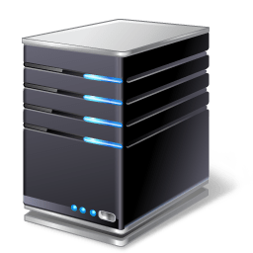



Denial of Service
Authorized user
Authentication Server
Logon request
Bogus logon requests

Slide 4

Denial of Service
Authorized user
Authentication Server
Logon request
Logon granted
Bogus logon requests

Slide 5
Denial of Service
Distributed Denial of Service
Authorized user
Authentication Server
Logon request
Bogus logon requests
Botnet

Slide 6
DDoS Types
Reflected
Amplified
Coordinated

Slide 7
Reflected DDoS
Time Server
Target
IP addr = 10.10.10.10
Service Request
Spoofed Source IP = 10.10.10.10
Service Request
Spoofed Source IP = 10.10.10.10

Slide 8
Amplified DDoS
Time Server
Target
IP addr = 10.10.10.10
Service Request (increase payload)
Spoofed Source IP = 10.10.10.10
Service Request (increase payload)
Spoofed Source IP = 10.10.10.10

Slide 9
Coordinated DDoS
Authorized user
Target
Service request
Bogus logon requests

